Slide 1
Income tax

Slide 2

Learning objectives
Understand and define tax and income tax
Know the different rates of tax for different salaries
Calculate the amount of income tax payable for different salaries

Slide 3


What is tax?
Tax is a contribution to support the government expenditure on areas such as education, health and public order and safety

Slide 4
What is tax?
Tax is compulsory and is charged on a variety of things, including income, property and commodities

Slide 5
What is tax?
Income tax is automatically deducted from wages and salaries, although the amount deducted depends on the total money earned

Slide 6
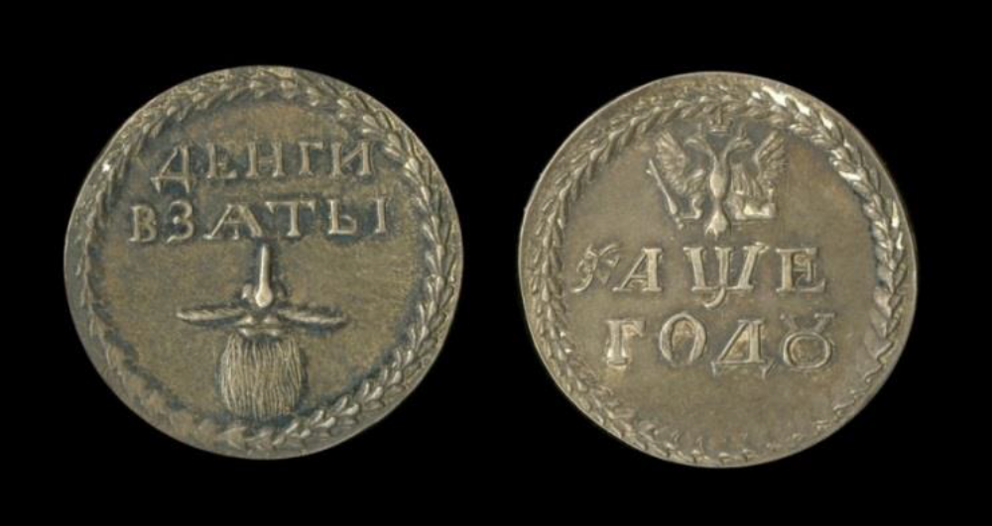
Beard tax!
In an attempt to modernise Russian society in the late 1600s and discourage the growing of facial hair, Peter the Great introduced a beard tax
Those who wished to grow a beard were taxed and given a token as proof of payment
Russian beard tax token issued by Peter the Great, 1705
© Trustees of the British Museum

Slide 7
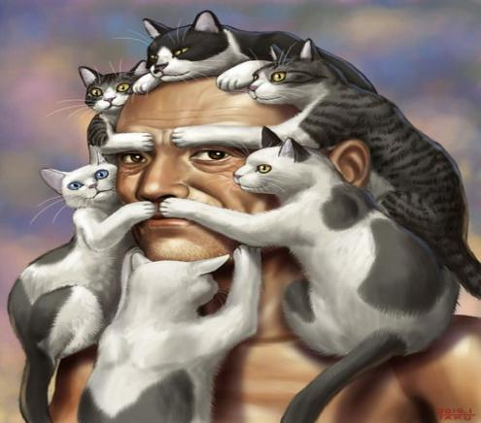
Beard tax!
What do you think bearded people’s reaction would be today if they were forced to pay a tax on their facial hair?

Slide 8

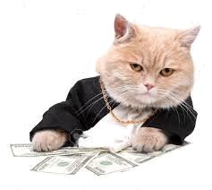
Tax in the UK
In the UK, everyone has a tax-free allowance on their earnings, which for the tax year 2016-2017 is £11,000

Slide 9
Tax in the UK
This means you can earn up to £11,000 a year without paying any tax on your income

Slide 10
Tax in the UK
You can earn up to £11,000 a year without paying any tax on your income
On earnings between £11,000 and £43,000, 20% is deducted for tax

Slide 11
Tax in the UK
You can earn up to £11,000 a year without paying any tax on your income
On earnings between £43,000 and £150,000, 40% is deducted for tax
On earnings between £11,000 and £43,000, 20% is deducted for tax

Slide 12
Tax in the UK
You can earn up to £11,000 a year without paying any tax on your income
The highest rate of 45% is deducted for tax on earnings over £150,000
On earnings between £11,000 and £43,000, 20% is deducted for tax
On earnings between £43,000 and £150,000, 40% is deducted for tax

Slide 13

How much tax?
Max is a pizza delivery cat
He earns £10,000 per year
How much income tax does he pay?
Nothing -- £10,000 is within the tax-free allowance
You can earn up to £11,000 a year without paying any tax on your income
On earnings between £11,000 and £43,000, 20% is deducted for tax
On earnings between £43,000 and £150,000, 40% is deducted for tax
The highest rate of 45% is deducted for tax on earnings over £150,000

Slide 14

How much tax?
Ifran is a waiter cat
He earns £15,000 per year
How much income tax does he pay?
The first £11,000 of Ifran’s income is tax-free
You can earn up to £11,000 a year without paying any tax on your income
On earnings between £11,000 and £43,000, 20% is deducted for tax
On earnings between £43,000 and £150,000, 40% is deducted for tax
The highest rate of 45% is deducted for tax on earnings over £150,000

Slide 15
How much tax?
Ifran is a waiter cat
He earns £15,000 per year
How much income tax does he pay?
He pays 20% on the remaining £4,000
You can earn up to £11,000 a year without paying any tax on your income
On earnings between £11,000 and £43,000, 20% is deducted for tax
On earnings between £43,000 and £150,000, 40% is deducted for tax
The highest rate of 45% is deducted for tax on earnings over £150,000

Slide 16
How much tax?
Ifran is a waiter cat
He earns £15,000 per year
How much income tax does he pay?
20% of £4,000 = £800
You can earn up to £11,000 a year without paying any tax on your income
On earnings between £11,000 and £43,000, 20% is deducted for tax
On earnings between £43,000 and £150,000, 40% is deducted for tax
The highest rate of 45% is deducted for tax on earnings over £150,000

Slide 17
How much tax?
Ifran is a waiter cat
He earns £15,000 per year
How much income tax does he pay?
So Ifran pays £800 in tax
You can earn up to £11,000 a year without paying any tax on your income
On earnings between £11,000 and £43,000, 20% is deducted for tax
On earnings between £43,000 and £150,000, 40% is deducted for tax
The highest rate of 45% is deducted for tax on earnings over £150,000

Slide 18
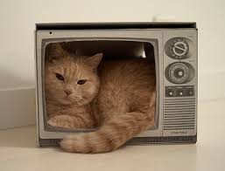
How much tax?
Khari is a TV producer cat
She earns £50,000 per year
How much income tax does she pay?
The first £11,000 of Khari’s income is tax-free
You can earn up to £11,000 a year without paying any tax on your income
On earnings between £11,000 and £43,000, 20% is deducted for tax
On earnings between £43,000 and £150,000, 40% is deducted for tax
The highest rate of 45% is deducted for tax on earnings over £150,000

Slide 19
How much tax?
Khari is a TV producer cat
She earns £50,000 per year
How much income tax does she pay?
The next £32,000 is taxed at 20%
You can earn up to £11,000 a year without paying any tax on your income
On earnings between £11,000 and £43,000, 20% is deducted for tax
On earnings between £43,000 and £150,000, 40% is deducted for tax
The highest rate of 45% is deducted for tax on earnings over £150,000

Slide 20
How much tax?
Khari is a TV producer cat
She earns £50,000 per year
How much income tax does she pay?
20% of £32,000 = £6,400
You can earn up to £11,000 a year without paying any tax on your income
On earnings between £11,000 and £43,000, 20% is deducted for tax
On earnings between £43,000 and £150,000, 40% is deducted for tax
The highest rate of 45% is deducted for tax on earnings over £150,000

Slide 21
How much tax?
Khari is a TV producer cat
She earns £50,000 per year
How much income tax does she pay?
The remaining £7,000 is taxed at 40%
You can earn up to £11,000 a year without paying any tax on your income
On earnings between £11,000 and £43,000, 20% is deducted for tax
On earnings between £43,000 and £150,000, 40% is deducted for tax
The highest rate of 45% is deducted for tax on earnings over £150,000

Slide 22
How much tax?
Khari is a TV producer cat
She earns £50,000 per year
How much income tax does she pay?
40% of £7,000 = £2,800
You can earn up to £11,000 a year without paying any tax on your income
On earnings between £11,000 and £43,000, 20% is deducted for tax
On earnings between £43,000 and £150,000, 40% is deducted for tax
The highest rate of 45% is deducted for tax on earnings over £150,000

Slide 23
How much tax?
Khari is a TV producer cat
She earns £50,000 per year
How much income tax does she pay?
£6,400 + £2,800 = £9,200
You can earn up to £11,000 a year without paying any tax on your income
On earnings between £11,000 and £43,000, 20% is deducted for tax
On earnings between £43,000 and £150,000, 40% is deducted for tax
The highest rate of 45% is deducted for tax on earnings over £150,000

Slide 24
How much tax?
Khari is a TV producer cat
She earns £50,000 per year
How much income tax does she pay?
So Khari pays £9,200 in tax
You can earn up to £11,000 a year without paying any tax on your income
On earnings between £11,000 and £43,000, 20% is deducted for tax
On earnings between £43,000 and £150,000, 40% is deducted for tax
The highest rate of 45% is deducted for tax on earnings over £150,000

Slide 25

Your turn!
From the website download the 2 documents
  Income tax questions
  Income tax questions help sheet
Now complete Income Tax Questions sheet
  You may find it easier to use the help sheet to assist you
Extension:
From the website download the document
  Income Tax Questions Extension
Work out how much pay each person receives after paying Income Tax
  By year , month and week
You can earn up to £11,000 a year without paying any tax on your income
On earnings between £11,000 and £43,000, 20% is deducted for tax
On earnings between £43,000 and £150,000, 40% is deducted for tax
The highest rate of 45% is deducted for tax on earnings over £150,000

